Slide 2
INTRODUCTION
As Andhra Pradesh embarks on a new journey of growth under the dynamic leadership of Hon’ble Chief Minister Sri. Y.S Jaganmohan Reddy Garu, Andhra Pradesh offers a model for progressive Economic Growth and Development in developing nations segment. Andhra Pradesh is currently ranked No. 1 in the DIPP ranking on Ease of Doing Business (EODB) among States in India. Recently, based on a year-long study of governance in Andhra Pradesh, Chief Minister Y S Jagan Mohan Reddy was conferred the SKOCH CM of the year for his leadership and bringing governance more efficient and transparent.
The Government of Andhra Pradesh ("AP Government") recently unveiled its new Industrial Policy 2020-23, Tourism Policy 2020-25, Food Processing Policy 2020-2025, Electronics & IT/ITES Policy 2021-24 with the aim to attract private investments for establishing industrial projects on massive scale in the state. The new policies focuses on creating a conducive ecosystem which makes industries based in Andhra Pradesh innovative and globally competitive.
The Key objectives of state Government is to support and plan balanced growth across regions and communities and to achieve environmentally sustainable growth and to enhance the quantum and quality of skilled manpower and to raise the per capital income of the state. That includes infrastructural development, ease of doing business measures, improving labour access / skilling, developing a support center for entrepreneurs, incentives, and special incentives for socially disadvantaged groups such as women members of the scheduled caste, scheduled tribes and other communities for establishments and thus enable the state as an attractive and competitive destination for industrial investments in the country.

Slide 3
ROLE OF APNRTS
Services Offered
Investments Guidance
Proposal Assessment
Polices and Benefits
Approval Management
Facilitating Inter-Department Coordination
Schemes Implementation & Processing
Andhra Pradesh Non-Resident Telugu Society is an Investment Promotion and Facilitation Agency for Telugu Diaspora to cater to the investment needs of NRTs for existing and prospective investors to get consolidated information about the investment process with regards to expanding their existing units (or) to set up new business unit as a prime growth engine for employment generation and overall socio-economic development of the state Andhra Pradesh.
Objective:
Promote & facilitate industrial investments into the state AP
Handholding support to the NRTs for setting up the investments
Act as a investment related comprehensive information for NRTs
Encourage NRTs to capitalise on state competitive advantages for doing businesses in AP
Focus sectors

Slide 4
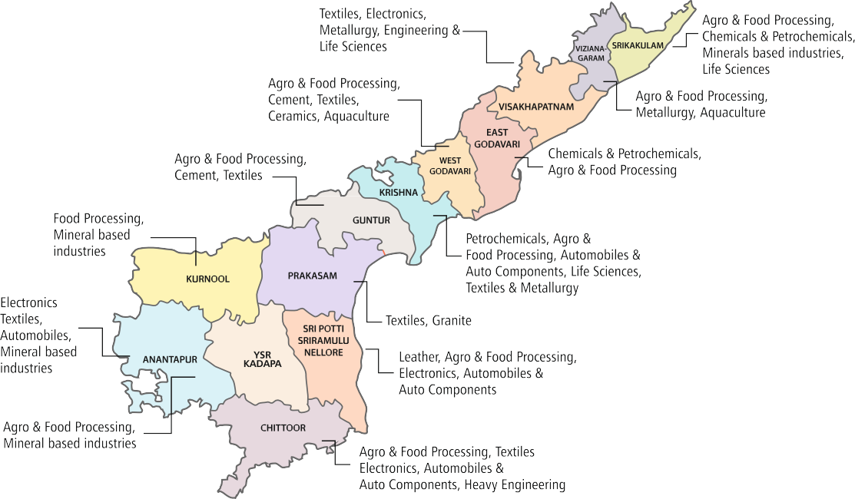
DISTRICT WISE INDUSTRIAL HUBS
YSR AP One would provide handholding support (to investors) during pre-establishment and setup of industrial units, post-setup support, backward and forward linkages and access to market and new technologies among other things through out the investment.
Classification of MSME Industrial Projects
S.NO | CLASSIFICATION | DESCRIPTION
1 | Micro Projects | Investment not more than Rs.1 crore and expected annual turnover less than Rs. 5 crores
2 | Small Projects | Investment not more than Rs.10 crore and expected annual turnover less than Rs. 50 crores
3 | Medium Projects | Investment upto Rs.75 crore and expected annual turnover less than Rs. 250 crores
4 | Large Projects | Invt. more than Rs. 75 crores and upto Rs.400 crores
5 | Mega Projects | Investment greater than Rs. 400 Crores

Slide 5
AP INDUSTRIAL DEVELOPMENT POLICY 2020-23
Incentives for Micro & Small Enterprises
Policy Objectives
Reimbursement of 100% Stamp duty & Transfer duty for
a) Purchased Land b) Lease of land/shed/mortgages & Hypothecations
Reimbursement of 100% of Net SGST Accrued to state for 5 years
24*7 Quality Power supply & Fixed Power Cost reimbursement for Rs. 1.00 per unit for 5 Years
15% Investment Subsidy on Fixed Capital Investment up to Rs. 20 Lakh
Reimbursement of 25% land Conversion Charges up to Rs. 10 Lakh
Interest Subsidy of 3% on term loan taken for a new enterprise
To achieve environmentally sustainable growth
To create employment for the youth of the state
To match the national average in industrial GVA per capita
To plan balanced growth across regions and communities
Incentives for Medium, Large & Mega Industries
Direct Employment Generated | SGST Reimbursement
1000 | 50%
1000-2000 | 75%
2000+ | 100%
Uninterrupted 24*7 Quality Power supply
Reimbursement of SGST (capped to FCI-Fixed Capital Investment) for 5 years to be linked to employment Creation.
Common Facilities like Waste Water Treatment, Continuous Emission Monitoring systems etc,.to be set up in APIIC Industrial Parks
Cont..

Slide 6
AP INDUSTRIAL DEVELOPMENT POLICY 2020-23
‘YSR Badugu Vikasam Scheme’ – Special Package for Entrepreneurs of SC, ST, BC & Minority Communities
100% Reimbursement | 50% | 25% | 35%
Stamp Duty & Transfer Duty | Rebate in Land Cost (up to 20 Lakhs) | Land Conversion Charges (up to 10 Lakhs) | Investment Subsidy (up to 50 Lakhs)
Stamp Duty for Lease of Land/Building & Mortgages
Net SGST to Micro & Small Enterprises (up to 5 years)
Fixed Power Cost Reimbursement at 1.50/unit for 5 years Interest subsidy of Up to 9% over and above 3% on term loan taken on the FCI for 5 years
Separate head of Accounts will be maintained to release the sanctioned incentives under Scheduled Castes Component Plan (SCP) & Scheduled Tribes component Plan (STC)

Slide 7
AP TOURISM POLICY 2020-25
Incentives for Tourism Projects
Policy Objectives
Reimbursement of 100% of net SGST accrued to state for all new units for a period of 5 years from COD(Commencement of Date) or up to realization of 100% fixed capital investment, whichever is earlier
Fixed Cost Power Reimbursement to New Tourism Units at Rs. 2.00 per unit for a period of 5 years from COD for all new Tourism Projects.
C. Reimbursement of 100% of stamp duty and transfer duty
D. 100% Waiver of Land Use Conversion charge
To develop a high-end luxury resorts in the state
To build institutional capacity for skill development in tourism sector
To promote responsible tourism practices among all tourism stakeholders
Land Lease Policy
Allotment of land i) annual lease rent ii) annual lease and revenue sharing iii) free hold basis.
The price for bidding for lease hold model shall be 1% of SRO (Sub Registrar Office) value of the land as the basic annual lease rent.
The Annual Lease rent(ALR) shall be enhanced by 5% of lease rent for every block of 3 years
For lease and revenue sharing basis, ALR shall be fixed 1% of SRO value with additional development premium (ADP) as percentage revenue share terms shall be the bidding parameter
Allotment on long lease basis – 33 years + 3 years for construction for other Tourism Projects
To attract and facilitate private investments and entrepreneurship in tourism
To position the state as a preferred tourism destination nationally & globally
Cont..

Slide 8
AP TOURISM POLICY 2020-25
Mega Tourism Projects/ 5 star and above
Projects with investment more than Rs.400 Crores shall be considered as Mega Tourism Projects
Mega Tourism Projects / 5 Star and above projects shall be accorded "Industry" status. 7 Star projects shall be encouraged
Mega Tourism Projects / 5 Star and above projects shall have special provisions for tailor-made incentives and direct allotment of land
Mega Tourism Projects / 5 Star and above projects proposals shall be processed via the State Investment Promotion Committee and State Investment Promotion Board for accord of any incentives and land allotment to have a more transparent and quick approval
Compared to previous policies for Mega Projects it is proposed to have 90-year lease with 4 years of construction period for Mega Projects / 7 Star projects
This would go a long way in making the project financially viable.

Slide 9
AP FOOD PROCESSING POLICY 2020-25
Promote Innovation, Research & Development
Fiscal Incentives for Micro and Small Enterprises
SCHEME |  | Incentives
Investment subsidy |  | 15% up to Rs. 20 lakhs for Micro and Small Enterprises 35% up to Rs. 50 lakhs for Farmers Producers Organizations (FPOs) 35% up to Rs.50 lakhs for BC/Minority Communities (women) 45% limited to Rs.1.00 crore for SC/ST Entrepreneurs
Interest Subvention |  | 3% to Micro and Small Enterprises for a period of 5 years 3% to Farmers Producers Organization for a period of 5 years 3% to BC/ Minority Communities (women) for a period of 5 years. Up to 9% over and above 3% for SC/ST Entrepreneurs from date of commencement of commercial production for a period of 5 years
To create modern infrastructure for agro food processing clusters
Encouraging
good agricultural practices for producing quality
Policy
Objectives
Establishing market linkages with commodity online platforms
To provide integrated and complete preservation infrastructure facilitates for FPOs
To impart entrepreneurship & skill development training to youth
All the incentives and other initiatives laid down in AP Industrial Policy 2020-23 are applicable and implemented in AP Food Processing Policy 2020-25
Cont..

Slide 10
AP FOOD PROCESSING POLICY 2020-25
Micro and Small Enterprises
SCHEME |  | Incentives
Land conversion charges |  | 25% land conversion charges upto Rs. 10 lakhs for MSEs, FPOs, BC/Minority Communities (women) and SC/ST Entrepreneurs
POWER COST Reimbursement |  | ₹ 1.00 per unit for 5 Years (General) ₹ 1.25 per unit for 5 years BC/Minority Communities (women), FPOs ( Farmers producers Organizations) ₹ 1.50 per unit for 5 years SC/ST Entrepreneurs from date of commencement of commercial production
Stamp duty/transfer duty/hypothecation |  | 100% Reimbursement for MSEs, FPOs, BC/Minority Communities(women) and SC/ST Entrepreneurs for purchase of land/shed/building, mortgage and hypothecation.
Land cost rebate |  | 50% land conversion charges upto Rs. 10 lakhs for MSEs, FPOs, BC/Minority communities (women) and SC/ST Entrepreneurs
Seed capital assistance |  | 25% of machinery cost for micro units to SC/ST Entrepreneurs
Quality Certification/ patent registration |  | 100% of cost incurred limited upto Rs. 3 lakhs for SC/ST Entrepreneurs
SGST Reimbursement |  | For micro & small units – 100% reimbursement of net VAT/CST/SGST for 5 years For medium units – 75% of net VAT/CST/SGST for 5 years For large/mega units – 50 % of net VAT/CST/SGST for 5 years
Other common initiatives |  | 16.2% of plots for SC Entrepreneurs 6% of plots for ST Entrepreneurs in industrial parks

Slide 11
Thrust Areas For Micro Enterprises
THRUST AREAS |  | Assistance for development
Development of Secondary Food Processing Clusters |  | Grant in aid @35% of eligible project cost up to 10.00 cores
Formalisation of Micro Food Processing Enterprises |  | 35% up to 10.00 lakhs per individual Micro Food processing units as credit-linked capital subsidy 50% up to 10.00 lakhs for Brand Building, Marketing support 35% up to 10.00 lakhs for common infrastructure support Seed capital assistance @ Rs. 40,000 per SHG (self-help-group) for working capital 35% of the eligible project cost with a maximum ceiling of Rs. 10.00 lakhs for FPOs
Development of skill development & incubation centres |  | Skill development and incubation centers to be setup by convergence with AP state skill development corporation (APSSDC) @1 for each district and also to work with premier research institutions like IIFPT.
Development of food Testing laboratories |  | Establishment of Food testing laboratories 1 for each district to analyze the food samples, reducing transportation time and ensure compliance and surveillance for monitoring the quality of domestic/international standards on food.
Cont..

Slide 12
Thrust Areas For Micro Enterprises
THRUST AREAS |  | ASSITANCE for development
Development of meat food processing industries |  | Enhancing meat production by distributing the Sheep's under YSR CHEYUTHA program through Animal Husbandry Department. Establishment of 3 three meat processing hubs in 3 districts i) Sankhavaram(East Godavari) ii) Vizianagaram iii) Kurnool
Promotion of processing in dairy sector |  | Enhancing milk production by distributing Milch animals under YSR CHEYUTHA program through Animal Husbandry Department. Strengthening and establishing New Milk cooling units Automatic milk collection units in partnership under AP-AMUL Project Establishment of 4 Mega milk processing hubs at Vizag,Ongole,Guntur,Pulivendula
Strengthening of value chain and secondary processing in fisheries sector |  | Proposed Secondary processing units with the support from Department of Fisheries, GoAP 150 Aqua bazars at constituency stage, 23 pre-processing and 10 processing units. Proposed 8 Fishing Harbours & 4 Fish Landing centres in each Coastal district.
Development of seed processing industries |  | Establishment of 2000 Primary Processing Units at RBK (Rythu Bharosa Kendralu) level under RKVY program and 50 Secondary Seed Processing Units at Constituency level for Packing and processing under national food security mission (NFSM)

Slide 13
AP ELECTRONICS POLICY 2021-24
Vision
Policy Objectives
This policy envisions…
“Transforming the State of Andhra Pradesh into a preferred investment destination for the Electronics sector while focusing on backward integration of the manufacturing value chain, moving beyond assembly operations”.
Focusing on upstream value chain & Capitalizing on growth in domestic consumption
Creating a robust Electronics ecosystem & Generating large scale employment for the Electronics manufacturing industry with ready talent pool and fulfilling demand for skilled human resource
Focusing on fast growing sub sector such as mobile phones, consumer electronics & electronic component manufacturing including batteries, screens, camera modules, printed circuit boards (PCBs)
Promoting innovation, R&D in the Electronics industry and ensuring continuous technology upgradation.
Cont..

Slide 14
AP ELECTRONICS POLICY 2021-24
Fiscal Incentives under the AP IT Policy (For Zone A and Zone B)
A) Stamp duty
Reimbursement of 100 percent stamp duty, transfer duty, and registration fee paid on sale/lease deeds on the first transaction only.
B) Investment subsidy
20 percent of Fixed Capital Investment (FCI) up to INR 20 Cr. for Electronics industries.
25 percent of Fixed Capital Investment (FCI) up to INR 25 Cr. for Electronics industries categorized as SC/ ST/ BC/ Women enterprises
C) SGST reimbursement
100 percent net SGST reimbursement for a period of 8 years.
D) Power tariff (Zone A) :- is defined as brownfield electronic manufacturing clusters developed by the Government of Andhra Pradesh or it’s agencies
24x7 uninterrupted power supply
Fixed power cost reimbursement of INR 1.00 per unit for a period of 5 years from the date of commencement of commercial production
Cont..

Slide 15
AP ELECTRONICS POLICY 2021-24
Fiscal Incentives under the Policy (For Zone A and Zone B)
Additional incentives in Zone B:- is defined as greenfield Electronics Manufacturing Clusters being developed by the
Government of Andhra Pradesh or it’s agencies.
For firms setting up in Zone B, the below incentives will be provided additionally:
A) Power tariff
24x7 uninterrupted power supply
The power tariff shall be invoiced at competitive rates of INR 4.50 per unit.
B) Logistics subsidy
Reimbursement of 25 percent of cost incurred on domestic transport up to a sum of INR 50 lakh p/a for 5 years.
Given increased interest by global Electronics industry firms in relocating their existing plants to India, as a special consideration, a reimbursement of 50 percent of cost incurred on import of manufacturing equipment, up to a sum of INR 2 Cr. shall be offered.
C) Interest subsidy
To provide interest subsidy on term loan @ 5 percent up to INR 1.50 Cr. per year for a period of 5 years.
Cont..

Slide 16
Production Linked Incentive (PLI) Scheme
The Electronics industries setting up operations in Zone B in the state as defined and qualifying for the PLI scheme as per its eligibility threshold criteria, may opt for incentives under the scheme.
a) Eligibility threshold criteria - Companies investing at least INR 100 Cr. or employment of 1,000 after date of notification of the policy shall be eligible for incentives under the scheme. Further, the list of specified items eligible for the scheme shall be listed in the operating guidelines to be released separately.
b) Financial incentive - The scheme shall extend an incentive of up to 5 percent on annual incremental sales (over base year) of goods manufactured in Andhra Pradesh and covered under target segments, to eligible companies, for a period of 10 years subsequent to the base year. Only the FCI invested after date of notification of the policy (i.e.) validity from 1st April 2021 until 31st March 2024.
Customized incentive package
The companies which are approved under the customized package of incentives shall be eligible to claim only such approved incentives. In order to be eligible under this package, the Electronics manufacturing unit/ company has to generate an employment of more than 4,000 people or invest INR 500 Cr. or above in the state.
i) Special incentive package for Semiconductor and LCD fabs
The Government of Andhra Pradesh will work with large investors with an investment over INR 7,500 Cr. (USD 1 Billion) to create a global fab manufacturing destination. The government will make efforts to not only fast track such investment proposals through a special committee setup but also ensure that these investors are ensured infrastructure and skilled manpower in a rapid manner.
ii) Encouraging State manufacturing firms in AP Government projects
iii) Preferential Market Access given to Electronics industry operating in Andhra Pradesh from the state Government time to time

Slide 17
AP IT/ITES POLICY 2021-24
Vision
Policy Objectives
Infrastructure Development
Facilitating creation of co-working spaces and satellite centers to enable seamless start of operations for IT units.
This policy envisions…
“Transform the ITE&C department into a revenue center to achieve self-sustenance and to generate large scale local employment in IT/ITES sector, with specific focus on innovation and emerging technologies, and ensure public data security”
For enabling growth…
“The ITE&C department will develop three state of the art concept cities that offer a significant cost advantage and speed of execution. The department also endeavors to establish an “integrated technology park” in Visakhapatnam consisting of an emerging technologies research university, incubation centers, Centers of Excellence, labs, co-working spaces, state data center (SDC) these will be developed as futuristic living spaces which would improve the quality of life of the citizens”
Boost “gig economy” by supporting freelancers & encourage the adoption of latest global trends in IT business model such as “Work from Home”
Promoting emerging technologies such as quantum computing, AI/ML, virtual reality, data Analytics, block chain, Fintech etc. & By Creating an industry - ready talent pool and fulfilling the demand for skilled IT manpower.
Promoting innovation, and startups through appropriate incentives and interventions & Enable quick approval for investment proposals and reduce time taken for operations.
Cont..

Slide 18
AP IT/ITES POLICY 2021-24
Fiscal Incentives under the AP IT Policy
Employment creation Incentive | High-End IT Job | Mid-level IT Job | Entry-level IT Job
Women/SC/ST/BC Enterprises eligible for Incentive of 15% of Annual salary | INR 1,50,000 per local employment position | INR 1,12,500 per local employment position | INR 75,000 per local employment position
A one-time incentive of 10% of Annual salary (General Category) | INR 1,00,000 per local employment position | INR 75,000 per local employment position | INR 50,000 per local employment position
Criteria for availing the eligible employment incentives will be defined in the operating guidelines
Work From Home Incentive | A one-time incentive of INR 20,000 per employment position to cover expenses related to remote working hardware, software, bandwidth costs etc.
Boost to gig economy | Reimbursement of 50% of cost of buying IT hardware such as laptop, internet dongle, furniture, up to INR 20,000 per gig worker. Subject to proof of executing gigs worth at least 3 lakhs from AP in the FY
Cont..

Slide 19
AP IT/ITES POLICY 2021-24
Fiscal Incentives under the AP IT Policy
Quality Certification | 50% reimbursement on quality certification charges up to INR 5 lakhs per firm.
Power Tariff | All IT companies operating in the state shall be eligible for industrial tariff towards their power consumption.
Transport subsidy | A transport subsidy of INR 500/- per employment per month shall be provided for a period of 2 years, capped to a maximum of INR 10 lakhs per firm.
Incentives to Training Institutes | Training institutes registered in the state and having a physical premises in the state shall be offered a one-time incentive of INR 10,000/- per local full-time direct employment position facilitated in the state.
Measures for Start-up ecosystem development | Government shall launch a flagship startup promotion scheme for early stage startups, Accelerate Startups in Andhra Pradesh (ASAP)’, offering plug and play office space, access to a network of investors, mentors and the State’s trained talent pool. These provisions and other common shared services shall be offered to startups on reasonable charges. A fund of funds of INR 100 Cr. shall be co-created in partnership with a consortium of Venture Capitals and Private Equity firms and universities, for funding startups in the State.
Cont..

Slide 20
AP IT/ITES POLICY 2021-24
Fiscal Incentives under the AP IT Policy
Measures for Start-up ecosystem development | Training programs for entrepreneurs with business ideas, to address knowledge gaps in understanding target market, business plan, tax laws, insurance, financial planning, promoting business, sales, service etc. would be imparted Access to market reports and surveys for early stage startups would be provided. Incubation centers shall be set up in areas notified by the Government from time to time. The department will strive to conduct hackathons and workshops for startups based in the State, in collaboration with Universities and colleges, to ensure continuous innovation, and to encourage the development of innovative solutions for Government to Citizen (G2C), and Government to Business (G2B) services and other Government use cases.a consortium of Venture Capitals and Private Equity firms and universities, for funding startups in the State. The startups which work on the application of emerging digital technologies such as AR/ VR, AI/ ML, IoT, Data Science, Robotics, 5th generation (5G) cellular network, Server less Computing, Natural Language Processing, Block chain etc., and those which address the primary sectors will be provided priority in allotment of plug and play space, access to talent pool, incubation centers, Centers of Excellence, prototyping labs etc
Cont..

Slide 21
AP IT/ITES POLICY 2021-24
Land Allotment for IT Industry | IT Firms | IT Campuses | IT Parks
Land Cost Incentive for IT Parks | Employee strength of 250 and minimum annual turnover of INR 15 Cr. Over the past 3 Years are considered. Responsibility of the company to ensure at least 500 entry level IT jobs per acre with in 3 yrs of date of allotment | The company has a current headcount of minim 10,000 people globally or turnover of INR 500 Cr. over the past 3 Years are considered. For foreign IT companies to develop their own IT campus it has to be among the Fortune 1000 company or has a market Capitalization worth of USD 50 million (Approx.350 Cr. ) Responsibility of the company to ensure at least 500 entry level IT jobs per acre with in 3 years of date of allotment. | For building a IT park the developer should have a prior experience of developing IT park(s) with cumulative built up space of minimum 10,00,000 sft. and minimum annual revenue of INR 25 Cr. For 3 Years are considered. The IT park developer must ensure an employment of at least 500 entry-level IT professionals or equivalent per acre in the IT park within 6 years of date of allotment. Proposals for development of IT parks with a minimum of 5,00,000 sft. Built-up space(excluding parking)
A one - time incentive of INR 50,000 per employment created capped at 60 % of the land value will be granted to the developer as a reimbursement on land cost, provided the IT park developer creates at least 5,000 entry-level jobs
Customised Incentive Package Mega projects generating of a minimum 5,000 entry-level IT jobs or with investment of at least INR 500 Cr. Will be approved under customized package of incentives.
The detailed criteria for eligibility for incentives will be outlined in the operational guidelines. The incentives to the eligible IT companies shall be disbursed within 6 months from the date of issue of the order. All land/space allotments and incentive approvals made by a designated agency, only on the recommendation of CCITEI
Separate head of Accounts will be maintained to release the sanctioned incentives under Scheduled Castes Component Plan (SCP) & Scheduled Tribes component Plan (STC)

Slide 22
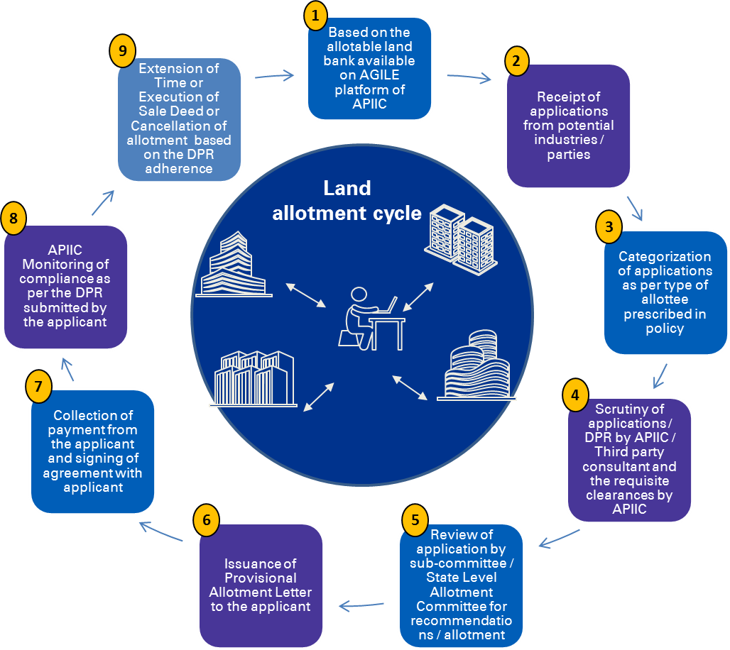
APIIC LAND ALLOTMENT PROCESS
Step 1: Explore land online/offline
Step 2: Apply online* for the selected plot or bulk land. During the online application, company has to submit statutory documents and Detailed Project Report (DPR) along with payment of EMD (10% of Land Cost)
Step 3: State Level Allotment Committee (SLAC) will study application and make a decision on allotment of land. SLAC sits every fortnight
Step 4: After approval from SLAC, company will automatically receive provisional allotment letter on their mail ID
Step 5: Payment of remaining land cost within 90 days
Step 6: Agreement to Sale
Step 7: Sale Deed on completion of operationalization of the project
*”LA for Others” process can be followed for land not in possession of APIIC. In this APIIC collects funds from company and acquires land for them.

Slide 23
CHECKLIST OF DPR COMPONENTS
APIIC’s application process mandates the submission of DPR along with other statutory documents and below are the checklist of Detailed Project Report components. An Applicant can submit its application for land allotment directly through the online application portal available at APIIC’s website: https://kpi.apiic.in:8443/ApiicWeb/login.jsp
https://kpi.apiic.in:8443/ApiicWeb/APIIC%20%20Online%20Application.jsp – (Online Application User Manual)
Company Profile and details of existing business concerns
This section shall elaborate on the existing company, its products/ services, strengths, market position, annual turnover, years of existence, etc. Statutory documents such as Certificate of Incorporation and Audited Annual Reports (of past 3 financial years) / IT returns / Net worth certificates (as the case may be) shall be submitted.
2. Documentary evidence/ proof to showcase the experience of successfully executing similar projects in past (if any)
Details of the existing business units, (if any), in terms of capacity/scale, investment made, direct employment, space utilization, etc. shall be provided. In case of a new firm, justification based on the past experience of the management shall be provided.
3. Brief on the proposed project
This section shall provide details on the project for which land is sought from APIIC. The project details must provide information on the type of products/services proposed, process flows, brief on technologies (without revealing proprietary details) and any other information that is relevant to impart an understanding of the proposed activity.
Cont..

Slide 24
CHECKLIST OF DPR COMPONENTS
4. Market analysis/ justification for proposed project
This section shall present a business case while elaborating on the ‘target market identification’ and ‘demand - supply dynamics’.
5. Justification for the extent of land required for the proposed project
This section shall include the layout of the proposed project (clearly highlighting the area utilization) and detailed area break - up for each of the components proposed (including built - up areas, open areas, roads etc.)
6. Implementation Timeline for various phases of the proposed project
7. Investment proposed in various phases & Means of Finance
8. Proposed Employment to be generated (Direct & Indirect) in various phases:
Break-up shall be provided of the employment estimates, in terms of managerial staff, engineering staff, administrative, labour, etc.
9. Financial analysis to justify the feasibility of the proposed project
This section shall include the assumptions on cost and revenues on a time line (yearly/Quarterly), projected Profit & Loss Statement and cash flow statements along with financial viability indicators like NPV, IRR, DSCR, etc.

Slide 25
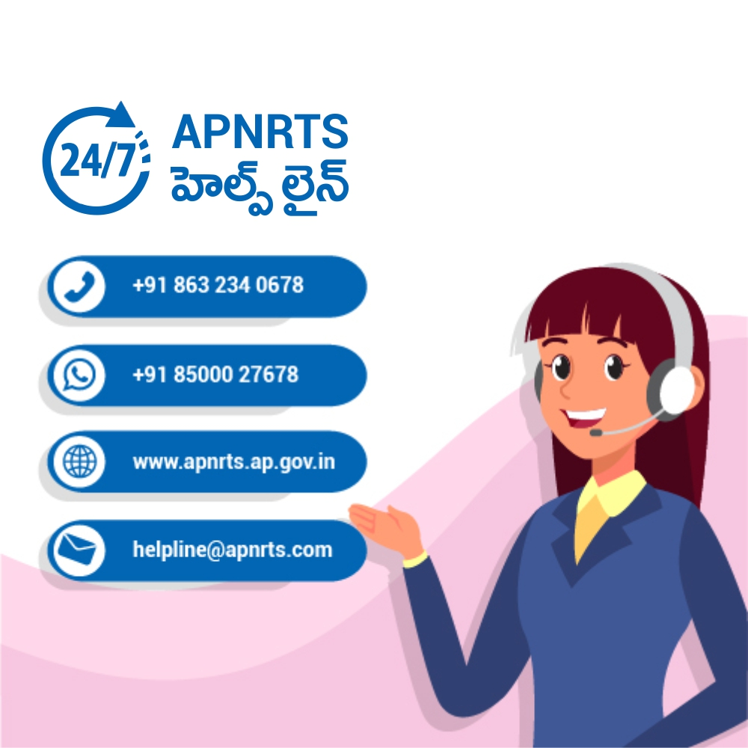
Following social Media Platforms are used to propagate the services and activities of APNRT Society:
https://www.apnrts.ap.gov.in/
investment@apnrts.com
https://www.facebook.com/APNRTSOCIETY/
https://twitter.com/APNRTSOfficial
https://www.instagram.com/apnrtsofficial/
http://www.youtube.com/c/APNRTS
https://www.linkedin.com/in/APNRT-society/

Slide 26
APNRT Society welcomes you
to collaborate in Andhra Pradesh’s vision of inclusive and sustainable growth story
THANK YOU

